Slide 1
Objectives of Parasites causing anaemia:
1- Students become able to identify different parasites causing anaemia.
2- Able to differentiate between parasitic causes and other causes of anaemia.
3- Know the main symptoms and history items help suspecting a parasitic cause.
4- Identify type of anaemia associated with each parasite.
5- Describe the life cycle of the causing parasites.
6- Be aware of the world epidemiologic distribution of [hook worms, malaria and Babesia] blood parasites.
7- Decide and apply the appropriate method(s) for the diagnosis of parasites causing anaemia.

Slide 2
Anaemia
In parasitic diseases; Several mechanism can contribute in lowering haemoglobin level:
1- Splenic sequestration & destruction of normal red cells
2- Haemolysis
3- Blood loss and consequent iron deficiency anaemia
4- Vitamin B12 deficiency
5- Bone marrow affection

Slide 3
Parasites causing anaemia
Examples:
1- Ancylostomidae [Hook worms]
>>> Microcytic Hypochromic Anaemia
2- Diphyllobothrium latum [Broad, fish tapeworm]
>>> Macrocytic Hyperchromic Anaemia
3- Malaria
>>> Hemolytic Anaemia

Slide 4
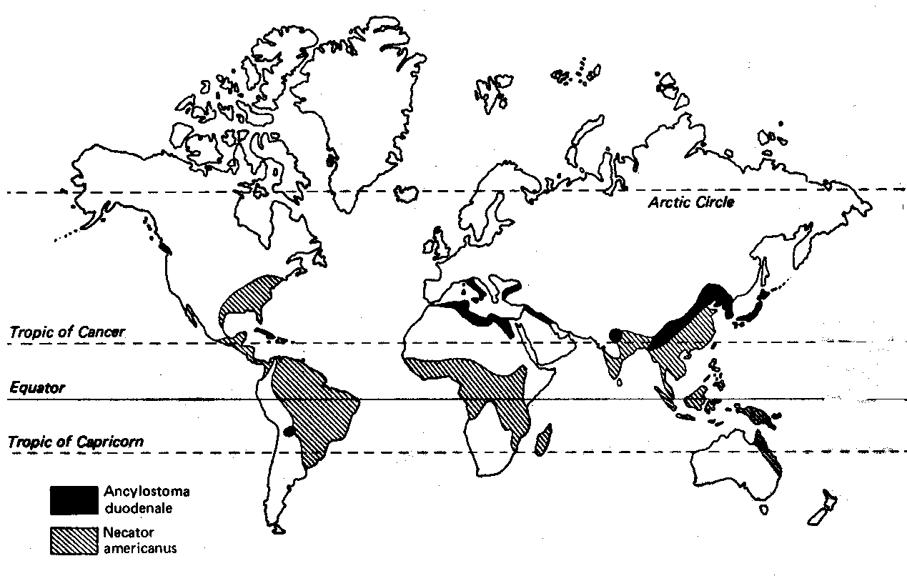
Ancylostomidae [Hook worms]
The two major hookworms which infect man are:
1- Ancylostoma duodenale [Old World Hookworm].
2- Necator americanus [New World Hookworm].

Slide 5
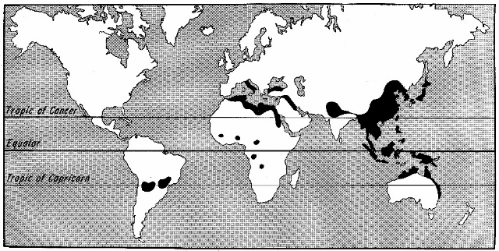
Ancylostoma duodenale
Disease: Ancylostomiasis.
Distribution:
North Coast of Africa, Southern Europe, Northern India, North China and Japan.
Host: Man.
Habitat: Small intestine [They mainly inhabit the jejunum & ileum
and rarely the duodenum].

Slide 6
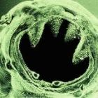
Morphology
Adult:
Cylindrical, grayish white or pink in colour.
Anterior end is bent dorsally.
It has a big mouth capsule provided with:
a- 2 pairs of ventral teeth.
b- 2 plates at the dorsal margin.
c- 2 sub ventral lancets at the bottom of the capsule.

Slide 7
Morphology
Male:
Up to 1 cm in length.
Female:
Up to 1.2 cm in length.
Esophagus:
Club-shaped
(1/6 of body length).

Slide 8
Morphology
Egg:
Size: 60 x 40 μm.
Shape: Oval with blunt poles & thin shell.
[empty space between the shell and contents].
Colour: Translucent.
Contents: Immature ovum (4 cell stage).
Egg is a diagnostic stage.

Slide 9
Morphology
Rhabditiform larva:
- About 0.25- 0.5 mm in length.
- Long buccal cavity.
Rhabditiform esophagus(1/3 body length).
- Pointed tail.

Slide 10
Morphology
Filariform larva
It is the infective stage:
- About 0.7 mm in length.
- Cylindrical esophagus
(1/4 body length).
- Sheathed.
- With sharply pointed tail.

Slide 11
Tropism of filariform Larvae
- Positive Thermotropism.
- Positive Histotropism.
- Positive Hygrotropism.
- Positive Phototropism.
- Positive Chemotropism.
Negative Geotropism
Filariform larva is attracted to man by
the turning of all or part of an organism in a particular direction in response to an external stimulus
Notes:
11

Slide 12
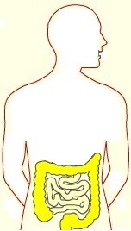
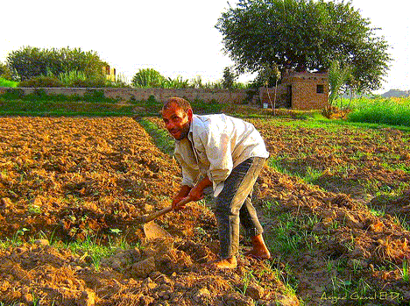
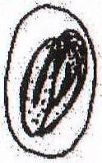
Life Cycle of Ancylostoma duodenale
Infected human
Negative geotropism
Positive hygrotropism
Thermotropism
Infective filariform larva
Rhabditiform larva
Geohelminthic infection
1st moult
Develops in soil
2nd moult

Slide 13
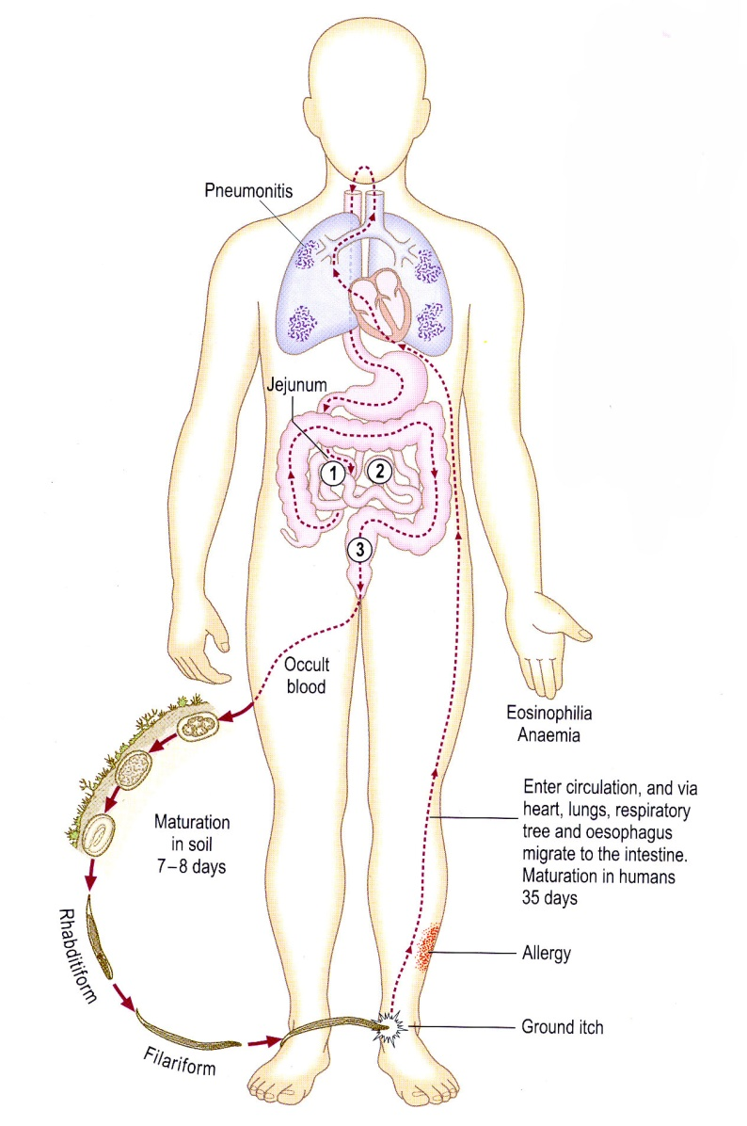

Slide 14
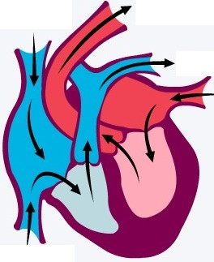
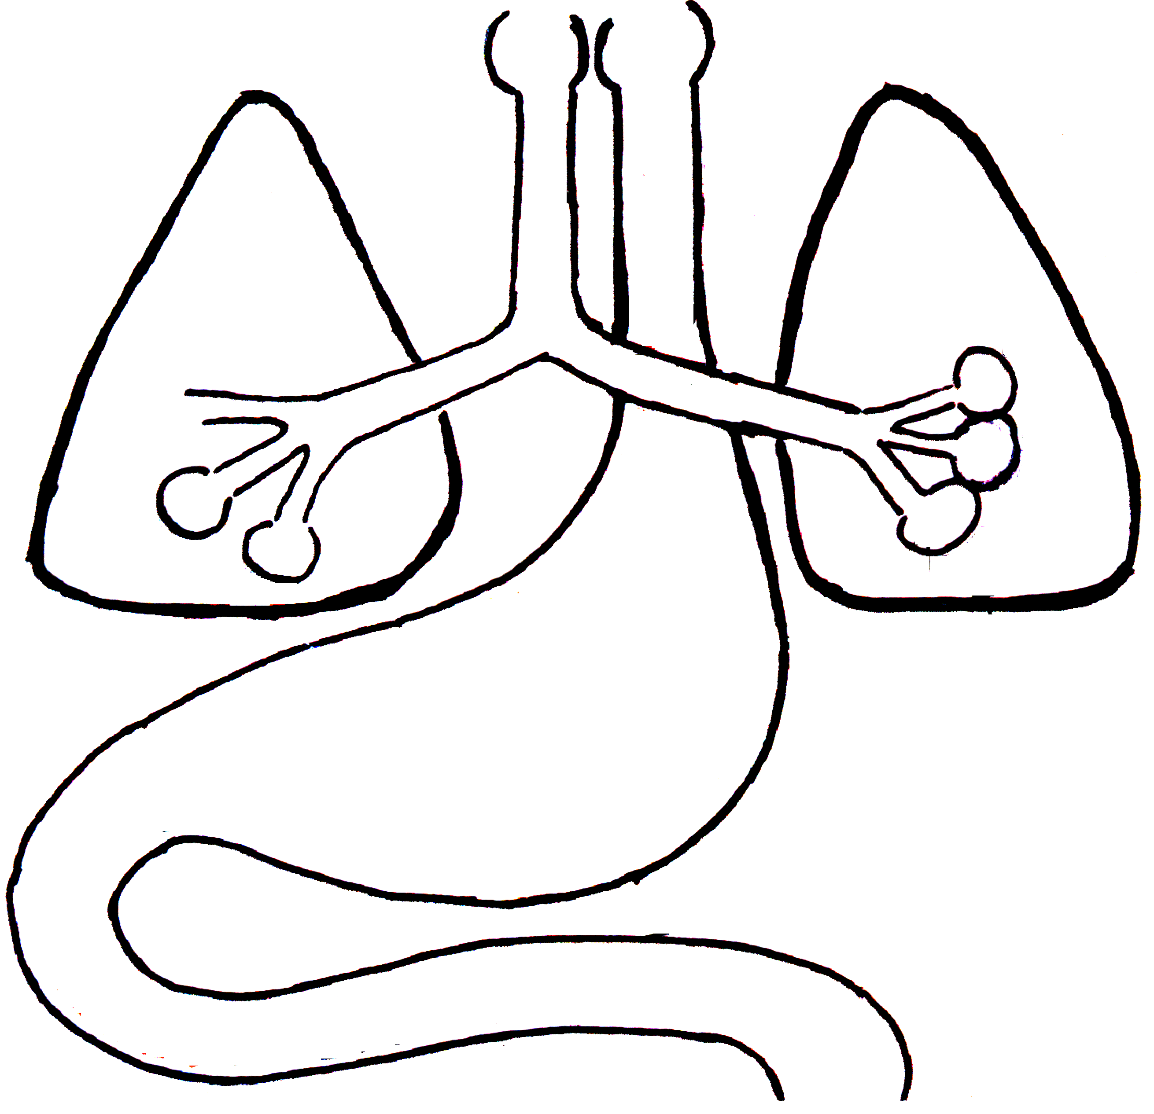
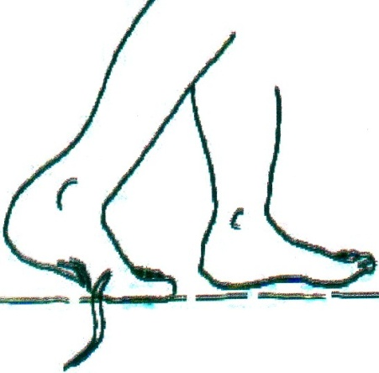
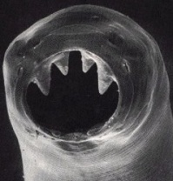
Cycle of Ancylostoma duodenale within the human body
Larva is swallowed
Pulmonary lesion
3rd moult
Venous blood
Skin lesion
Adult Ancylostoma
4th moult
Intestinal lesion
Filariform larva
jejunum

Slide 15
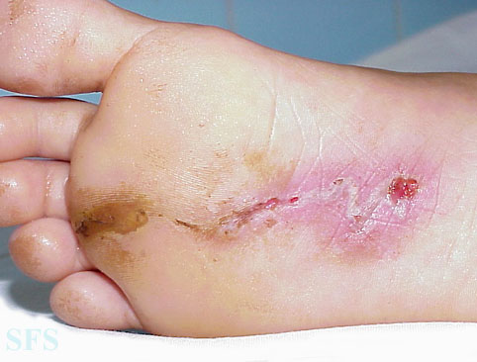
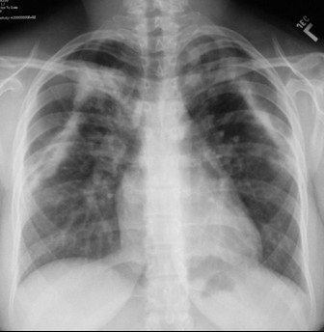
Pathology & clinical picture
Pathology is caused mainly by the presence of
adult worms in the intestine & less frequently
by penetration & migration of infective larvae.
Larvae cause skin & lung manifestations
1-Skin manifestation [Ground itch or hookworm dermatitis]: It is an allergic reaction to the penetrating filariform larvae. There is itching, erythema & rash. 2nd bacterial infections aggravate the condition.
2- Pulmonary manifestation [Loffler's syndrome]:
Passage of larvae in the lungs leads to minute haemorrhages & pneumonitis. There may be fever, cough, dyspnea, haemoptysis, leucocytosis & eosinophilia [up to 70%].
Plain X ray of lungs
shows scattered mottling
Notes:
15

Slide 16
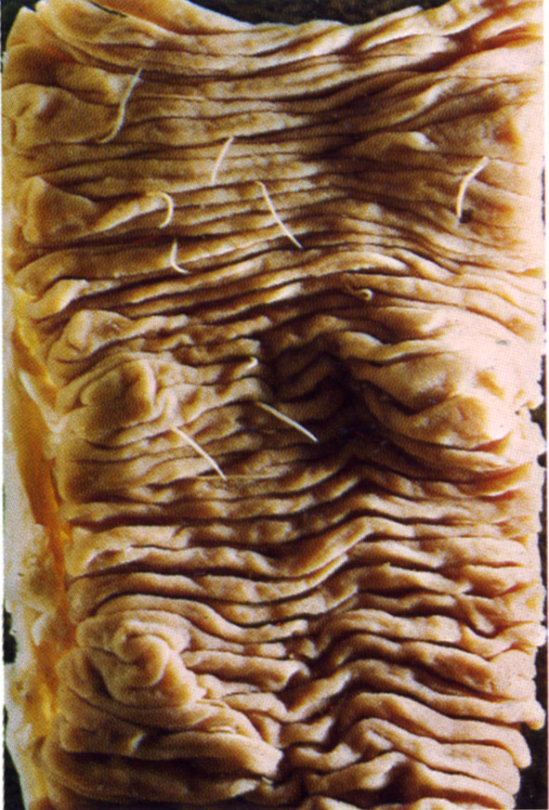
Pathology & Clinical picture (Cont.)
3- Intestinal Manifestation:
Worm attaches itself to the mucosa with its strong buccal capsule & teeth digesting the part of the villi which it has sucked in its mouth
Depending upon:
the number of worms,
duration of infection &
nutritional status of the patient,
adult worms cause:
Attachment of a hookworm to intestinal mucosa for feeding

Slide 17
1- Anaemia [Hypochromic microcytic anaemia]: due to
a- Ingestion of blood by worms (about 0.3-0.5 ml blood/worm/day).
b- Bleeding at sites of attachment.
c- Oozing of blood from sites previously attached by worms.
d- Depression of haemopoietic system.
Severe anaemia: ---> Weakness, pallor, fatigue, dyspnea, tachycardia & oedema [specially when it is combined with nutritional deficiency].
2- Hypoproteinaemia: due to both malabsorption & blood loss
3- Intestinal ulcers:
Present at site of attachment & may be infected → lead to abdominal discomfort, flatulence, nausea, vomiting, diarrhoea or constipation .
Melaena & occult blood in stool may occur.
4- Pica: habitual ingestion of non-food substances as soil
Oedema

Slide 18
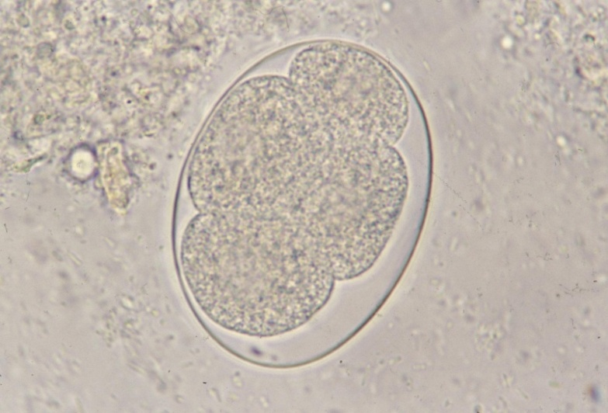
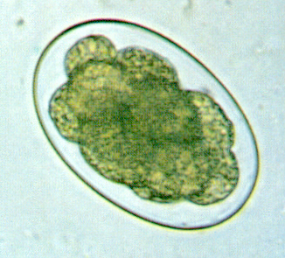
Diagnosis: Clinical & Laboratory
Laboratory:
1- Stool examination: for eggs.
N.B.: If the stool sample is freshly passed, the egg contains 4 cell stages. In constipated patients or if the stool is left for few hours, eggs appear containing morula or larval stage.
2- Blood picture: for anaemia & eosinophilia.
3- Testing for occult blood in stool.
Notes:
Occult blood can be detected by strip test or rapid test
18

Slide 19
Treatment of Ancylostomiasis
1- Albendazole:
Single dose of 400 mg for adult & 200 mg for children.
2- Mebendazole (Vermox):
100 mg twice daily / for 3 days.
3- Iron supplement.
4- Protein rich diet.
Notes:
19

Slide 20
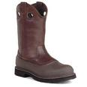
Prevention and control
1- Treatment of patients.
2- Sanitary disposal of human excreta.
3- Health education.
4- Wearing protective clothes.
5- Killing filariform larvae of Ancylostoma
in soil by larvicides.
X
Notes:
20

Slide 21
Epidemiology
1- Ancylostomiasis is more common in tropics, subtropics & some temperate zones.
2- Ancylostomiasis is widespread in areas where people defecate onto soil and don’t wear shoes and in mines, pottery where workers handle mud.
3- Ancylostomiasis is widespread where suitable temperature, rainfall and loose sandy soil are available.

